Slide 1
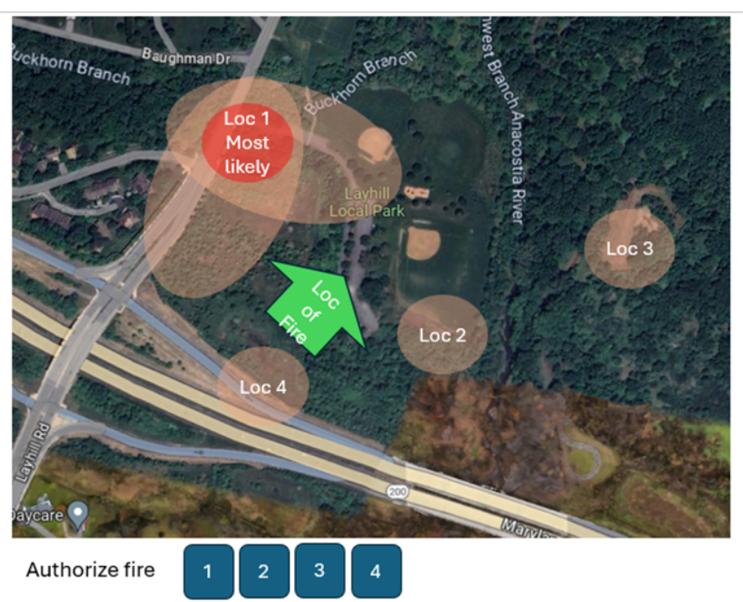
Audio Selection
1 | 2 | 3 | 4
Loc 1 satellite Visual Feeds Select a sensor | Loc 1 Aux Select another source when avaiable | Loc 2 sat | Loc 2 Aux | Loc 3 sat | Loc 4 Aux | Loc 4 Sat | Loc 4 Aux
System Status
Instrument Cluster: EACH ITEM PAIRED WITH A PROBABILITY DIST. OF TARGET AND CIVILIAN PRESENCE BY LOCATION Also, Hide/Show various Overlays of the data on the map where applicable
Radar Spectrometer | Ground Clutter Measurements
Rader Echoes Readout 1-4 | Heat Signatures
Overall Sensor Confidence 1-4
Historical Data+ Parzen Window Overlay | Object Recognition 1-4
Pre-Detection Controls | Post-Detection Controls
Interfering Signals Monitor, System Noise | Signal Shape
Uniform Aperture Config (phase) | Tapered Aperture Config
Doppler 1-4 (plus angle) | Antenna Sidelobes 1-4
Contact Commanding Officer | Log
Comms with Troops or Pilots
Show friendly positions | Friendly fire probability
Weapons and Operator Tools
Selection of weapon | Weapon Readiness/Status
Available weapons and their characteristics | Weapon Inventory counts
Weapon locations, distance, time to target, blast radius. Overlay blast radius toggle
Speed, angle, and trajectory of incoming fire with a confidence measure
Nature of Fire, Impact on Counterfire capabilities
Time since impact | show escape routes
Press to open CAI operators manual | Press to open relevant law and ethics
RECALCULATE BASED ON TARGET ESCAPING
Supplemental Orders Incoming Readout
Civilian Presence Decision by Counterfire 1-4
Current threshold and top 5 factors contributing to decision, with individual confidence measures
Legal and Ethical Considerations spotted by the computer

